Slide 1

Bootstrap 4
Welcome to

Slide 2
Outline
A look at Front-end frameworks
Bootstrap version 4
Why Bootstrap ?
Download Options
Major Bootstrap Components
Using Icons with Bootstrap
Demo
Sample Login Page

Slide 3





Front-End Frameworks
Front-end CSS frameworks let you hit the ground running when developing a new website.
a wide array of front-end frameworks are available, and new ones emerge on a regular basis.

Slide 4

Bootstrap v4
An open source front-end tool kit to develop mobile-first responsive websites.
Developed by Twitter in 2011 and has been regularly updated since then.
Has extensive documentation to guide you through
Ideal for beginners and those who prefer robust front-end framework

Slide 5
Why Bootstrap ?
Most of the CSS work is done for you.
Easy to get started
Great Grid System
Extensive list of components
JS Plugins
Great Documentation

Slide 6
Download Options
Option 1: Compiled CSS and JS
Option 2: Source Sass, JS and documentation files
Option 3: Bootstrap CDN (Content Delivery Network)
For more Info: https://getbootstrap.com/docs/4.0/getting-started/download

Slide 7
Major Components: Container
The most basic layout element in Bootstrap.
<div class="container"> <!-- Content here --> </div>
<div class="container-fluid"> <!-- Content here --> </div>

Slide 8
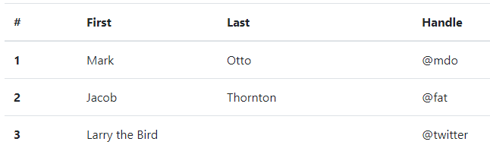
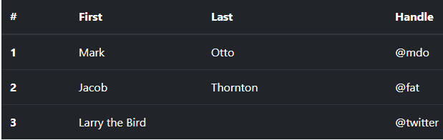
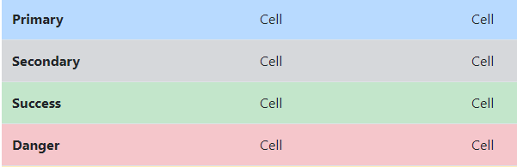
Major Components: Tables
Important Classes
.table
.table-dark/light/….
.thead-dark/light/…..
.table-striped
.table-hover
.bg-primary/…

Slide 9
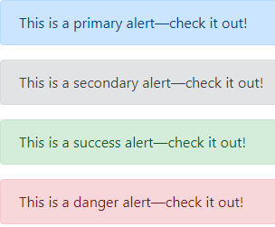
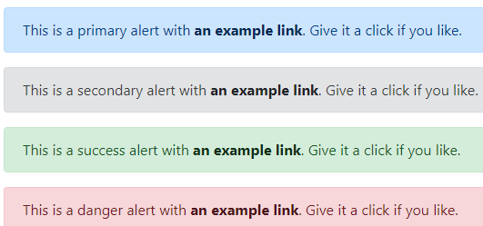
Major Components: Alerts
Important Classes
.alert
.alert-primary/secondary/…
.alert-link
.alert-dismissible

Slide 10
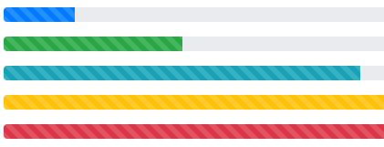
Major Components: Progress Bar
Important Classes
.progress
.progress-bar
.progress-bar-striped
.progress-bar-animated
Style=“width:x%”

Slide 11


Major Components: Buttons
Important Classes
.btn
.btn-primary/secondary/…
.btn-outline-primary/secondary/…
.btn-block

Slide 12
Major Components: Grid System
Bootstrap includes a responsive, mobile first fluid grid system that appropriately scales up to 12 columns.
used for creating page layouts through a series of rows and columns that house your content
Rows must be placed within a .container class for proper alignment and padding.
Use rows to create horizontal groups of columns.
Content should be placed within columns, and only columns may be immediate children of rows.

Slide 13
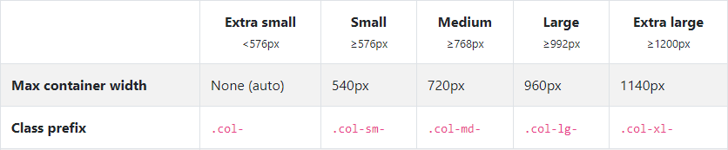
Major Components: Grid System
<div class="container">
<div class="row">
<div class="col-sm"> One of three columns </div>
<div class="col-sm"> One of three columns </div>
<div class="col-sm"> One of three columns </div>
</div>
</div>

Slide 14
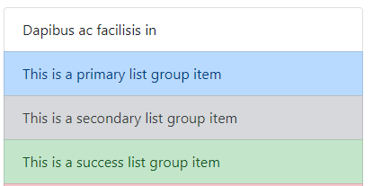
Major Components: List Groups
Important Classes
.list-group
.list-group-item
.active
.list-group-item-action
.list-group-item-primary/secondary…

Slide 15
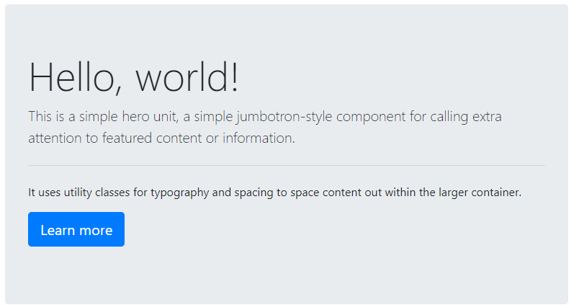
Major Components: Jumbotron
Important Classes
.jumbotron
.jumbotron-fluid

Slide 16
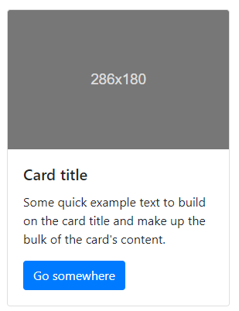
Major Components: Cards
Important Classes
.card-group
.card
.card-image-top
.card-header
.card-body
.card-title
.card-text
.card-footer
.border-primary

Slide 17
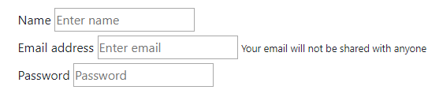
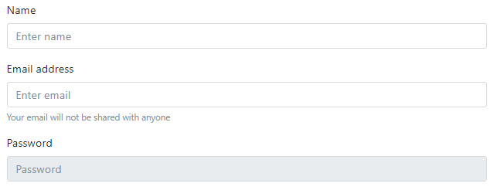
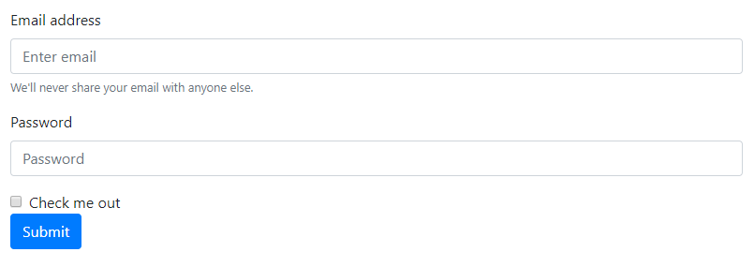
Major Components: Forms
Important Classes
.form-group
.form-control
.form-check
.form-check-label
-form-check-input
.is-valid
.is-invalid
.invalid-feedback

Slide 18
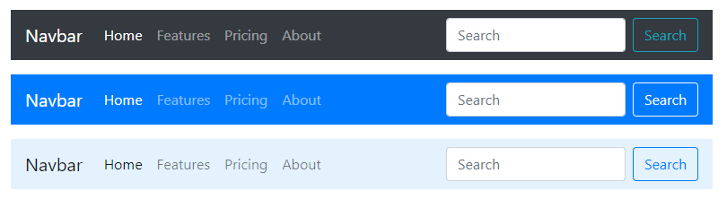
Major Components: Navbar

Slide 19
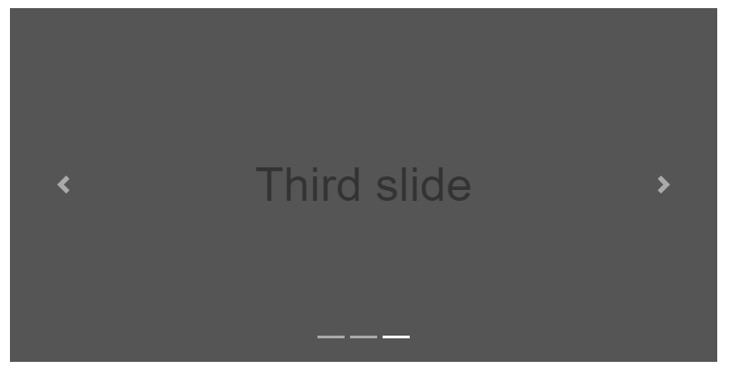
Major Components: Carousel

Slide 20
Using Icons with Bootstrap
Bootstrap does not include icons library
But recommends
Iconic
Octicons
Can also work with other libraries such as:
Google Material icons
Glyph
Font Awesome

Slide 21
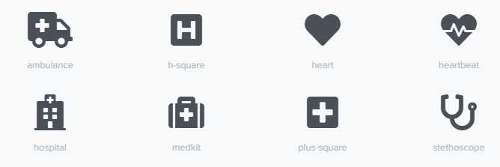
Using Font Awesome with Bootstrap
Can use the font awesome CDN to deliver a cached version to your web projects
Can also get a copy of the latest version and use it alongside your project source code.
For more: https://fontawesome.com/get-started

Slide 22
Components Not Covered
Badges
Breadcrumb
Drop Downs
Input Groups
Modal
Etc.

Slide 23
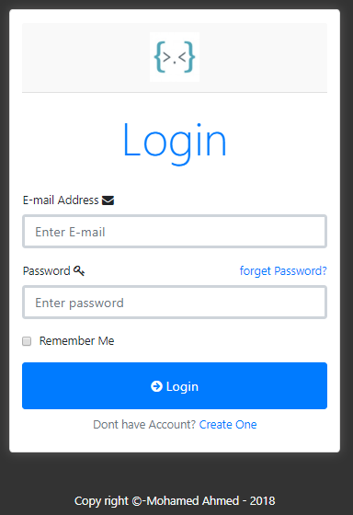
Sample Login Form

Slide 24
Thank You

